Slide 1
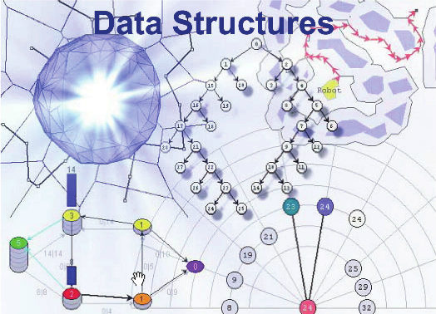

External Memory Geometric Data Structures
“Dynamic Interval Stabbing”
Amir Mesrikhani
Combinatorial and Geometric Algorithms Lab
Department of Computer Science.Yazd University

Slide 2
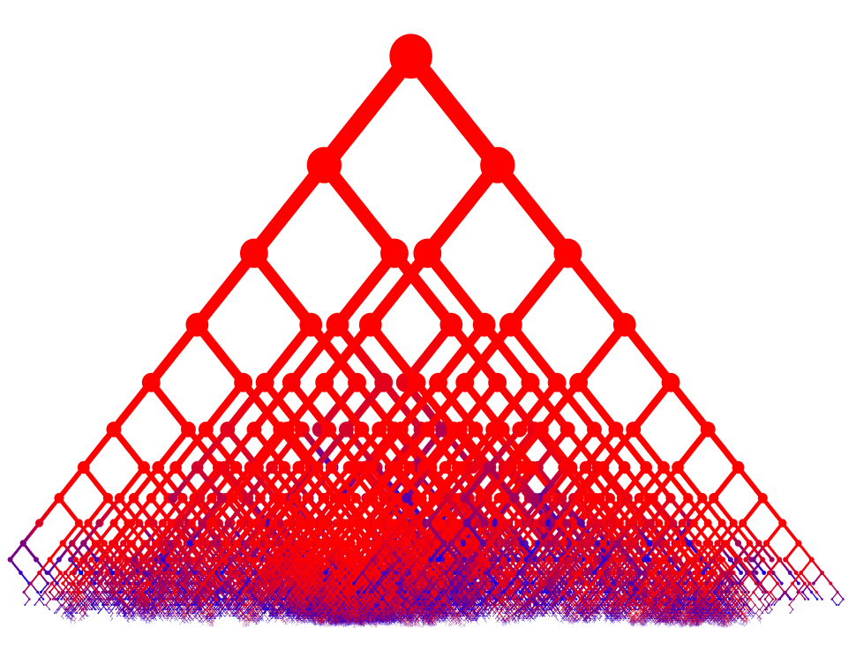
Dynamic Interval Stabbing
Internal Interval tree
External Interval tree
Internal Priority Search Tree
External Priority Search Tree
Combinatorial and Geometric Algorithms Lab
Department of Computer Science.Yazd University

Slide 3
Dynamic Interval Stabbing
We want to maintain a dynamically changing set of (one-dimensional) intervals I such that given a query point q we can report all T intervals containing q efficiently.
q
Combinatorial and Geometric Algorithms Lab
Department of Computer Science.Yazd University

Slide 4
Persistent Data Structure
In some applications we are interested in being able to access previous versions of data structure
Persistent Data Structure
Maintain one structure at all times
element keep track of the existence interval
Combinatorial and Geometric Algorithms Lab
Department of Computer Science.Yazd University

Slide 5
Static Interval Stabbing
The static version of the stabbing problem (where the set of intervals is fixed) can easily be solved I/O-efficiently using a sweeping idea and a persistent B-tree.
Answer a stabbing query at time q
q
Combinatorial and Geometric Algorithms Lab
Department of Computer Science.Yazd University

Slide 6
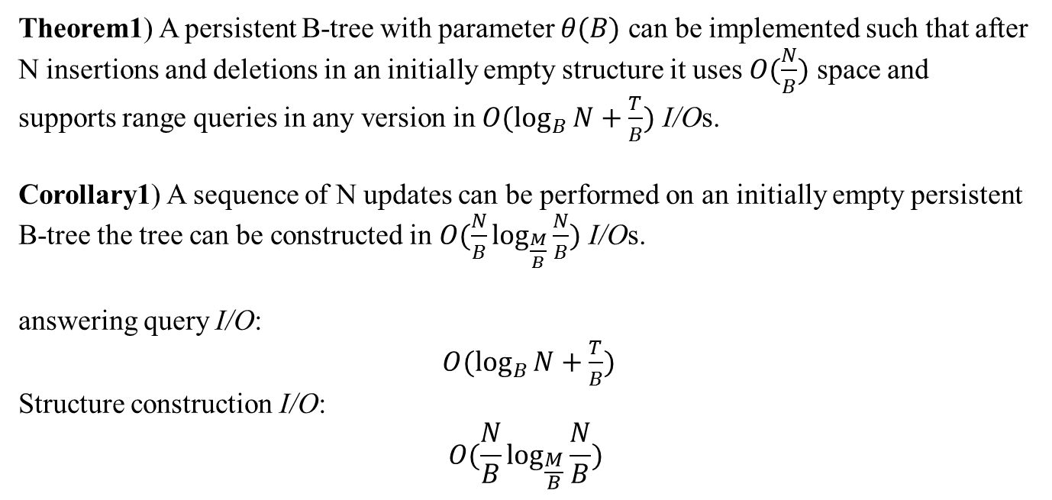
Static Interval Stabbing
Theorem1) A persistent B-tree with parameter $θ(B)$ can be implemented such that after N insertions and deletions in an initially empty structure it uses $O(\frac{N}{B})$ space and supports range queries in any version in $O(\log_{B}{N}+\frac{T}{B})$ I/Os.
Corollary1) A sequence of N updates can be performed on an initially empty persistent B-tree the tree can be constructed in $O(\frac{N}{B}\log_{\frac{M}{B}}{\frac{N}{B}})$ I/Os.
answering query I/O:
$O(\log_{B}{N}+\frac{T}{B})$
Structure construction I/O:
$$O(\frac{N}{B}\log_{\frac{M}{B}}{\frac{N}{B}})$$
Combinatorial and Geometric Algorithms Lab
Department of Computer Science.Yazd University

Slide 7
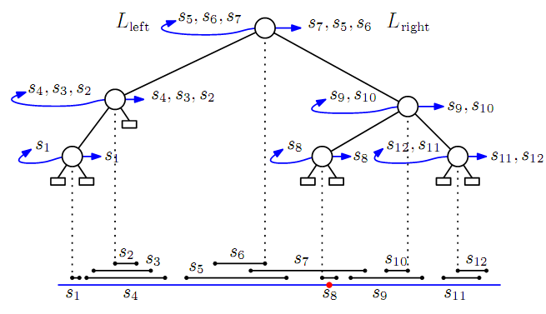
Internal Interval Tree
Consider internal memory
Combinatorial and Geometric Algorithms Lab
Department of Computer Science.Yazd University

Slide 8
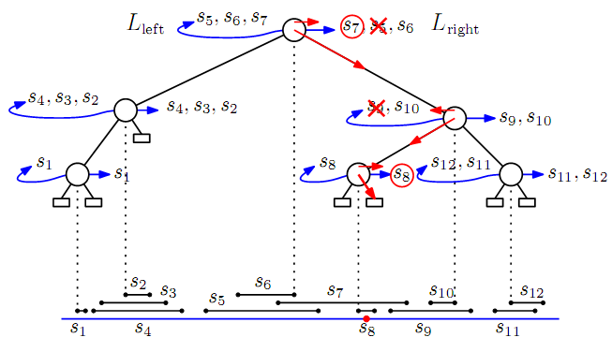
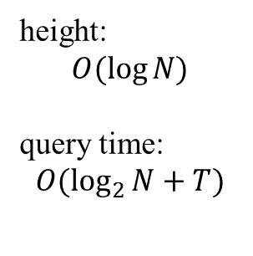
Interval Tree
height:
$$O(\log{N)}$$
query time:
$$O(\log_{2}{N}+T)$$
Combinatorial and Geometric Algorithms Lab
Department of Computer Science.Yazd University

Slide 9
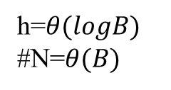
Interval Tree
Natural idea:
h=$θ(logB)$
#N=$θ(B)$
Combinatorial and Geometric Algorithms Lab
Department of Computer Science.Yazd University

Slide 10
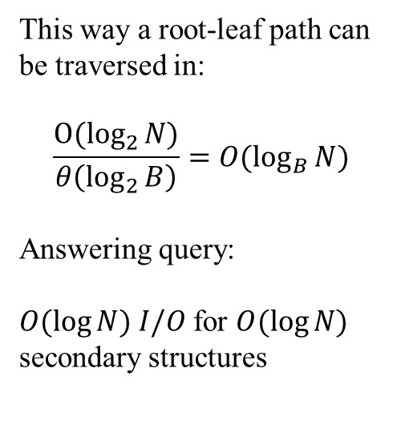
Interval Tree
Natural idea:
This way a root-leaf path can be traversed in:
$$\frac{{O(log}_{2}{N)}}{θ\left(\log_{2}{B}\right)}=O(\log_{B}{N})$$
Answering query:
$O(\log{N) I/O }$for $O(\log{N)}$ secondary structures
Combinatorial and Geometric Algorithms Lab
Department of Computer Science.Yazd University

Slide 11









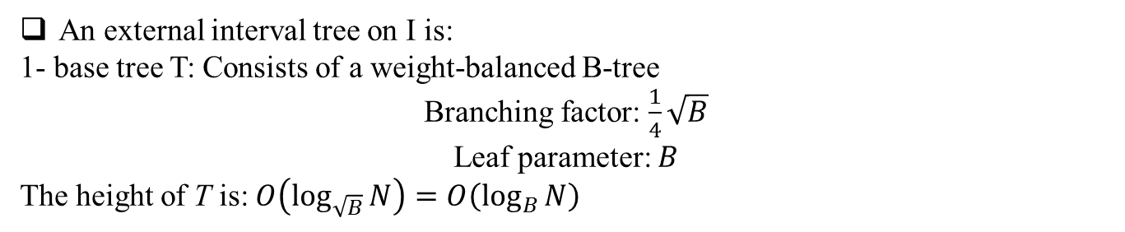





External Interval Tree
An external interval tree on I is:
1- base tree T: Consists of a weight-balanced B-tree
Branching factor: $\frac{1}{4}\sqrt{B}$
Leaf parameter: $B$
The height of T is: $O\left(\log_{\sqrt{B}}{N}\right)=O\left(\log_{B}{N}\right)$
$$b_{1}$$
$$b_{2}$$
$$b_{3}$$
$$b_{4}$$
$$b_{5}$$
$$b_{6}$$
slab
$$v$$
multislab
slab boundary
$$v_{1}$$
$$v_{2}$$
$$v_{3}$$
$$v_{4}$$
$$v_{5}$$
$$X_{v_{1}}$$
$$X_{v}$$
Combinatorial and Geometric Algorithms Lab
Department of Computer Science.Yazd University

Slide 12






External Interval Tree
In a node v of T we store intervals from I that cross one or more of the slab boundaries associated with v but none of the slab boundaries associated with parent(v).(secondary structures associated)
$$v$$
$$v_{1}$$
$$v_{2}$$
$$v_{3}$$
$$v_{4}$$
$$v_{5}$$
Combinatorial and Geometric Algorithms Lab
Department of Computer Science.Yazd University

Slide 13








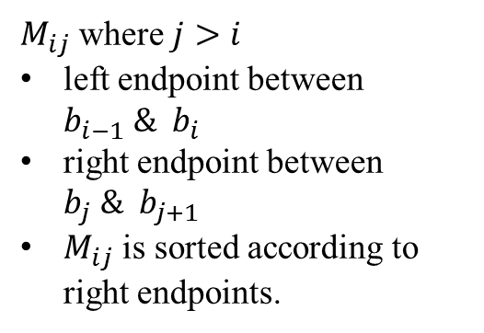
Secondary Structures
We store the set of intervals $I_{v}⊆I$ associated with v in the following $θ(B)$ secondary structures associated with v.
$$b_{i−1}$$
$$b_{i}$$
$$b_{i+1}$$
$$b_{j}$$
$$b_{j+1}$$
$$v$$
$M_{ij}$ where $j>i$
left endpoint between $b_{i−1} \& b_{i}$
right endpoint between $b_{j} \& b_{j+1}$
$M_{ij}$ is sorted according to right endpoints.
left slab list $L_{i}$
right slab list $R_{i}$
Combinatorial and Geometric Algorithms Lab
Department of Computer Science.Yazd University

Slide 14
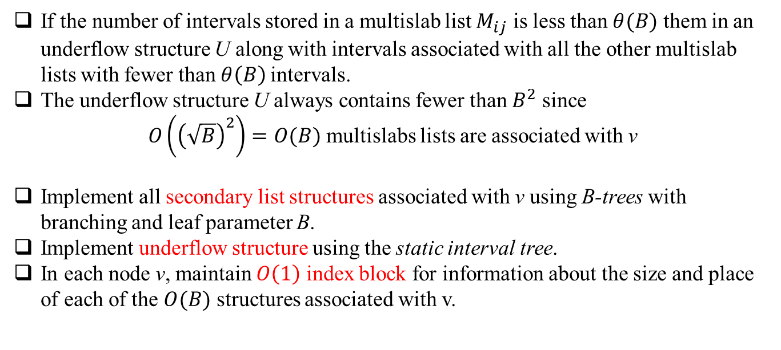
Multislab List and Implementation
If the number of intervals stored in a multislab list $M_{ij}$ is less than $θ(B)$ them in an underflow structure U along with intervals associated with all the other multislab lists with fewer than $θ\left(B\right)$intervals.
The underflow structure U always contains fewer than $B^{2}$ since
$O\left({\left(\sqrt{B}\right)}^{2}\right)=O(B)$ multislabs lists are associated with v
Implement all secondary list structures associated with v using B-trees with branching and leaf parameter B.
Implement underflow structure using the static interval tree.
In each node v, maintain $O\left(1\right)$ index block for information about the size and place of each of the $O(B)$ structures associated with v.
Combinatorial and Geometric Algorithms Lab
Department of Computer Science.Yazd University

Slide 15

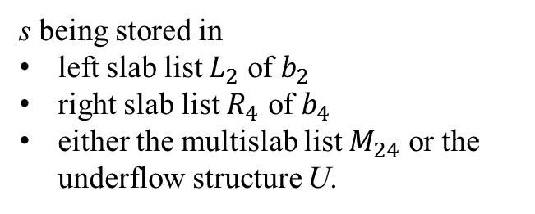







Space of External Interval Tree
With the definitions above, an interval in $I_{v}$ is stored in two or three structures.
$$b_{1}$$
$$b_{2}$$
$$b_{3}$$
$$b_{4}$$
$$b_{5}$$
$$b_{6}$$
s being stored in
left slab list $L_{2}$ of $b_{2}$
right slab list $R_{4}$ of $b_{4}$
either the multislab list $M_{24}$ or the underflow structure U.
$$v$$
$$s$$
Combinatorial and Geometric Algorithms Lab
Department of Computer Science.Yazd University

Slide 16
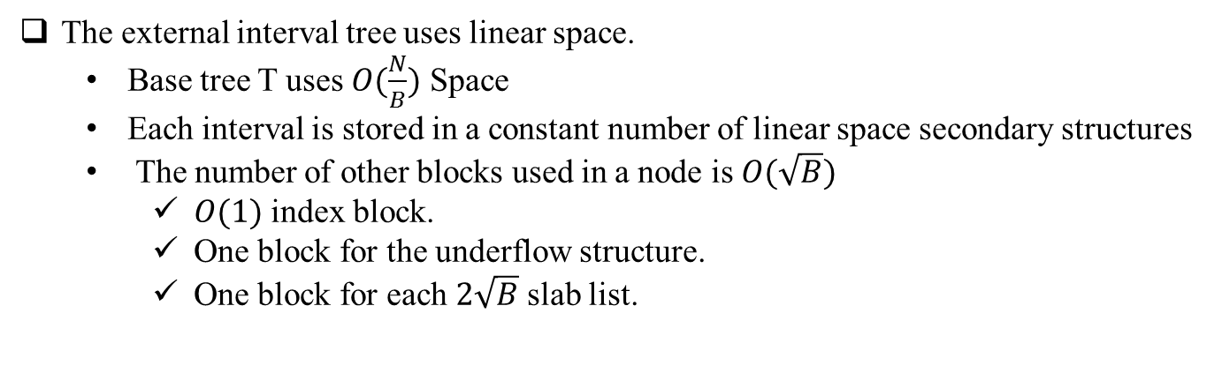
Space of External Interval Tree
The external interval tree uses linear space.
  Base tree T uses $O(\frac{N}{B})$ Space
  Each interval is stored in a constant number of linear space secondary structures
  The number of other blocks used in a node is $O(\sqrt{B})$
    $O(1)$ index block.
    One block for the underflow structure.
    One block for each $2\sqrt{B}$ slab list.
Since T has $O(\frac{N}{B\sqrt{B}})$ internal node so the structure uses a total $O(\frac{N}{B})$ space.
Combinatorial and Geometric Algorithms Lab
Department of Computer Science.Yazd University

Slide 17


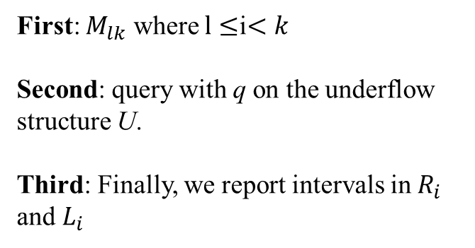

Query Algorithm
we search down T for the leaf containing q, reporting all relevant intervals among the intervals $I_{v}$ stored in each node v encountered.
$$q$$
First: $M_{lk}$ where $l≤$i$<k$
Second: query with q on the underflow structure U.
Third: Finally, we report intervals in $R_{i}$ and $L_{i}$
$$b_{i}$$
$$b_{i+1}$$
Combinatorial and Geometric Algorithms Lab
Department of Computer Science.Yazd University

Slide 18

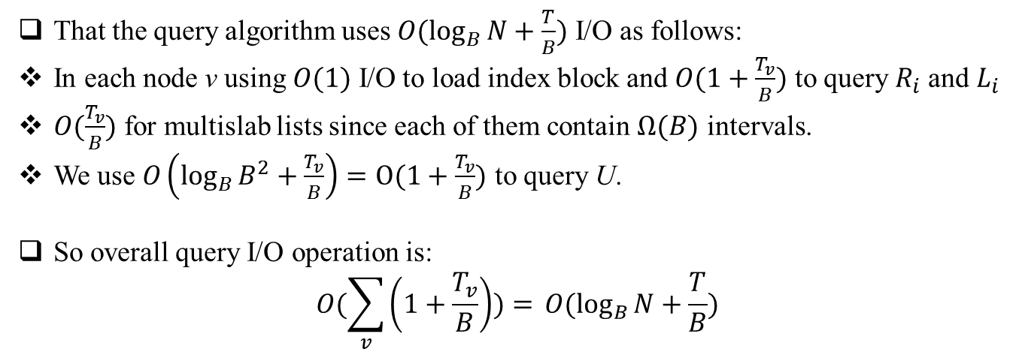
Number of I/O For Query Algorithm
That the query algorithm uses $O(\log_{B}{N}+\frac{T}{B})$ I/O as follows:
In each node v using $O(1)$ I/O to load index block and $O(1+\frac{T_{v}}{B})$ to query $R_{i}$ and $L_{i}$
$O(\frac{T_{v}}{B})$ for multislab lists since each of them contain $Ω(B)$ intervals.
We use $O\left(\log_{B}{B^{2}}+\frac{T_{v}}{B}\right)=O(1+\frac{T_{v}}{B})$ to query U.
So overall query I/O operation is:
$$O(\sum_{v}{\left(1+\frac{T_{v}}{B}\right))=} O(\log_{B}{N}+\frac{T}{B})$$
Combinatorial and Geometric Algorithms Lab
Department of Computer Science.Yazd University

Slide 19




Update
To insert or delete an interval s in the external interval tree we first update the base tree. Next we update the secondary structures.
If Performing an Insertion:
If Performing an deletion:
$$L_{i} and R_{j}$$
$$M_{ij} or U$$
$$L_{i} and R_{j}$$
$$M_{ij} or U$$
Combinatorial and Geometric Algorithms Lab
Department of Computer Science.Yazd University

Slide 20
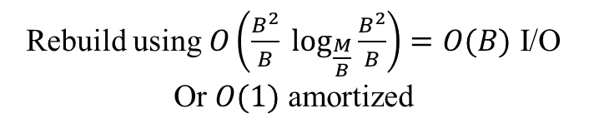

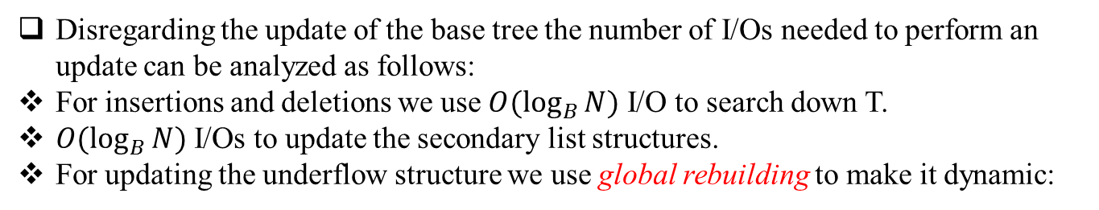
Update
Disregarding the update of the base tree the number of I/Os needed to perform an update can be analyzed as follows:
For insertions and deletions we use $O(\log_{B}{N})$ I/O to search down T.
$O(\log_{B}{N})$ I/Os to update the secondary list structures.
For updating the underflow structure we use global rebuilding to make it dynamic:
Once $B$ update collected
Rebuild using $O\left(\frac{B^{2}}{B} \log_{\frac{M}{B}}{\frac{B^{2}}{B}}\right)=O(B)$ I/O
Or $O(1)$ amortized
Update block
What about answering query on U?
Combinatorial and Geometric Algorithms Lab
Department of Computer Science.Yazd University

Slide 21
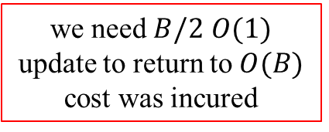


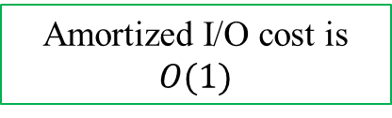
Update
Consider cases where $θ(B)$ intervals are moved between U and a multislab list $M_{ij}$.
$O\left(B\right)$ I/O
Amortized I/O cost is $O(1)$
we need $B/2$ $O(1)$ update to return to $O(B)$ cost was incured
Overall the update performed in ${O(log}_{B}{N})$ I/O
Combinatorial and Geometric Algorithms Lab
Department of Computer Science.Yazd University

Slide 22
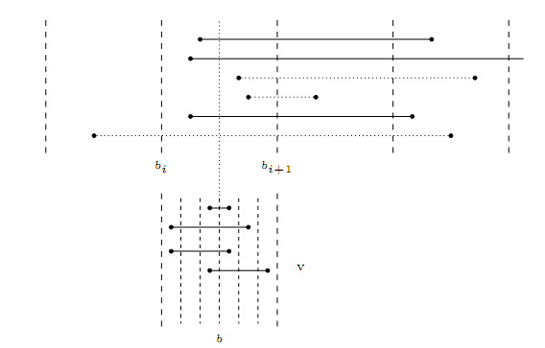
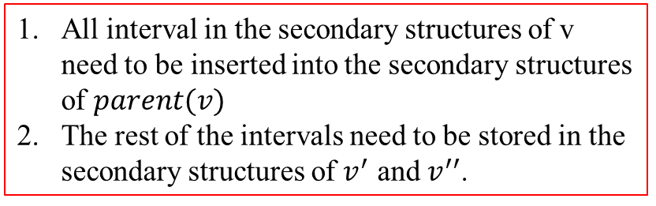
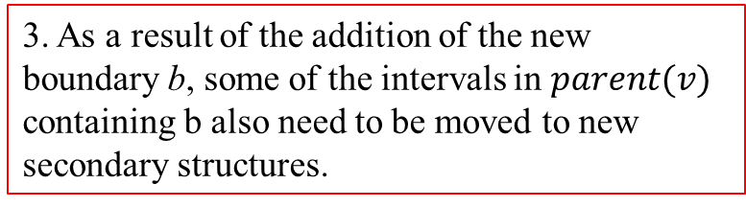
Update
Now consider the update of the base tree T which takes $O(\log_{B}{N})$ I/O.
v
All interval in the secondary structures of v need to be inserted into the secondary structures of $parent(v)$
The rest of the intervals need to be stored in the secondary structures of $v^{′}$ and $v^{′′}$.
3. As a result of the addition of the new boundary b, some of the intervals in $parent(v)$ containing b also need to be moved to new secondary structures.
v’
v’’
Combinatorial and Geometric Algorithms Lab
Department of Computer Science.Yazd University

Slide 23
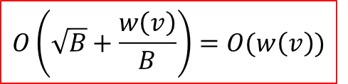



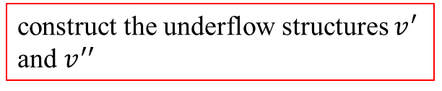
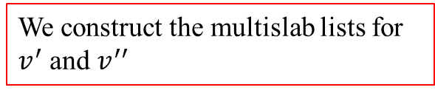
Update
First consider the intervals in the secondary structures of v.
By scanning through all of v's slab lists. we can collect all intervals containing b.
$$L_{l}$$
$$O\left(\sqrt{B}+\frac{w\left(v\right)}{B}\right)=O(w\left(v\right))$$
$$L_{r}$$
We construct the multislab lists for $v^{′}$ and $v^{′′}$
simply by removing all multislabs lists containing b
construct the underflow structures $v^{′}$ and $v^{′′}$
$O\left(\frac{w\left(v\right)}{B}\right)=O\left(w\left(v\right)\right)$ I/O
Combinatorial and Geometric Algorithms Lab
Department of Computer Science.Yazd University

Slide 24


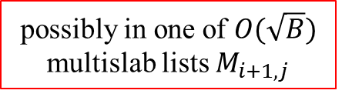
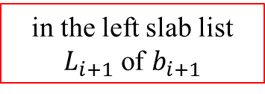
Update
Next consider $parent(v)$.
The intervals we need to consider all have one of their endpoints in $X_{v}$.
For simplicity we only consider intervals with left endpoint in $X_{v}$
in the left slab list $L_{i+1}$ of $b_{i+1}$
possibly in one of $O(\sqrt{B})$ multislab lists $M_{i+1,j}$
$O\left(\frac{\left|X_{v}\right|}{B}\right)=O\left(\frac{w\left(v\right)}{B}\right)=O(w\left(v\right))$ I/O
$O(w\left(v\right))$ I/O
Combinatorial and Geometric Algorithms Lab
Department of Computer Science.Yazd University

Slide 25
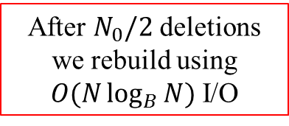
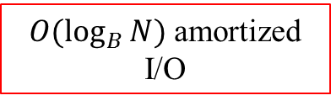
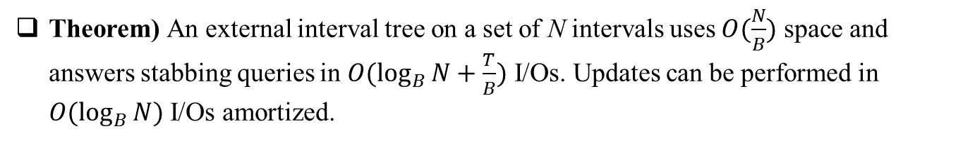

Update
Theorem) An external interval tree on a set of N intervals uses $O(\frac{N}{B})$ space and answers stabbing queries in $O(\log_{B}{N}+\frac{T}{B})$ I/Os. Updates can be performed in $O(\log_{B}{N})$ I/Os amortized.
During insertion we have split
$O(\log_{B}{N})$ amortized
I/O
After $N_{0}/2$ deletions we rebuild using $O(N\log_{B}{N})$ I/O
$O(\log_{B}{N}$) amortized
I/O
For delete we use global rebuilding
Combinatorial and Geometric Algorithms Lab
Department of Computer Science.Yazd University

Slide 26




3-Sided Planar Range Searching
Maintain a set S of point in the plane such that given a 3-sided query $q=(q_{1},q_{2},q_{3})$ we can report all points $(x,y)∈S$ with $q_{1}≤x≤q_{2}$ and $y≥q_{3}$
$$(q,q)$$
$$q_{3}$$
$$q_{1}$$
$$q_{2}$$
3-sided planar range searching
Interval stabbing problem
Combinatorial and Geometric Algorithms Lab
Department of Computer Science.Yazd University

Slide 27
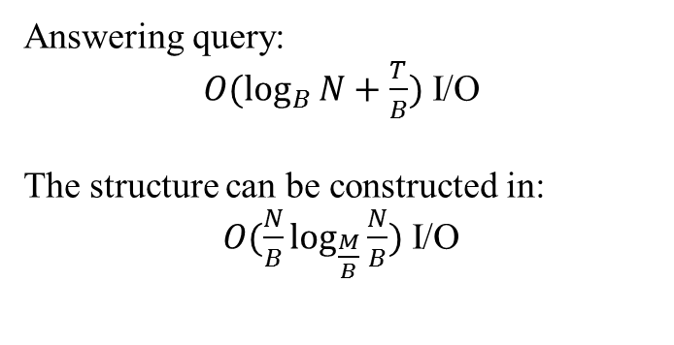
Static 3-Sided Planar Range Searching
we imagine sweeping the plane with a horizontal line
Answering query:
$O(\log_{B}{N}+\frac{T}{B})$ I/O
The structure can be constructed in:
$O(\frac{N}{B}\log_{\frac{M}{B}}{\frac{N}{B}})$ I/O
$$q_{3}$$
$$q_{1}$$
$$q_{2}$$
Combinatorial and Geometric Algorithms Lab
Department of Computer Science.Yazd University

Slide 28
Priority Search Tree
9
16,20
binay search on x-coordinate
heap on y-coordinate
4
16
5,6
19,9
1
5
13
19
1,2
9,4
13,3
20,3
1
4
5
9
13
16
19
20
4,1
Combinatorial and Geometric Algorithms Lab
Department of Computer Science.Yazd University

Slide 29


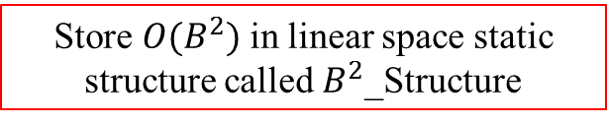
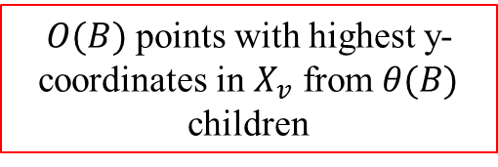
External Priority Search Tree
An external priority search tree consists of a weight-balanced base B-tree T with branching parameter $\frac{1}{4}B$ and leaf parameter B on the x-coordinates of the points in S.
An x-range $X_{v}$
$$v$$
$O(B)$ points with highest y-coordinates in $X_{v}$ from $θ(B)$ children
$$v_{1}$$
$$v_{2}$$
$$v_{3}$$
$$v_{4}$$
$$v_{5}$$
Store$O(B^{2})$ in linear space static structure called $B^{2}$_Structure
$O\left(\log_{B}{B^{2}}+\frac{T_{v}}{B}\right)=O(1+\frac{T_{v}}{B})$ I/O
Combinatorial and Geometric Algorithms Lab
Department of Computer Science.Yazd University

Slide 30
Answering Query
we start at the root of T and proceed recursively to the appropriate subtrees.
  Visit child v if
  v on path to q₁ or q₂
  All points corresponding to v satisfy query
Combinatorial and Geometric Algorithms Lab
Department of Computer Science.Yazd University

Slide 31
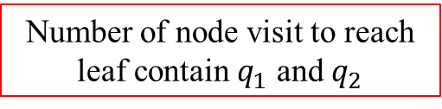


Answering Query
We use $O(\log_{B}{N}+\frac{T}{B})$ I/O to answer query.
$$O(1+\frac{T_{v}}{B})$$
In each internal node
Number of node visit to reach leaf contain $q_{1}$ and $q_{2}$
$$O(\log_{B}{N})$$
The I/O cost is ${O(log}_{B}{N+\frac{T}{B})}$
Combinatorial and Geometric Algorithms Lab
Department of Computer Science.Yazd University

Slide 32
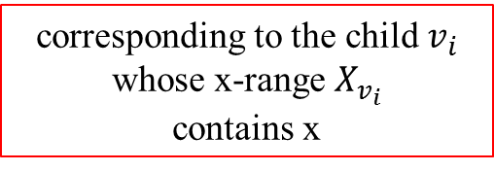

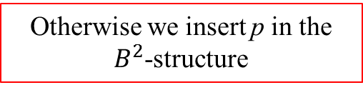
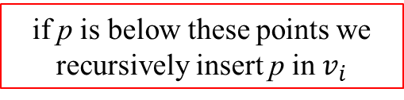
Update
To insert or delete a point $p=(x,y)$ in the external priority search tree, we first insert or delete x from the base tree T.
For Insertion we use bubble down procedure to update secondary structure
corresponding to the child $v_{i}$ whose x-range $X_{v_{i}}$
contains x
find the (at most) B points in the $B^{2}$-structure
if p is below these points we recursively insert p in $v_{i}$
Otherwise we insert p in the $B^{2}$-structure
Combinatorial and Geometric Algorithms Lab
Department of Computer Science.Yazd University

Slide 33
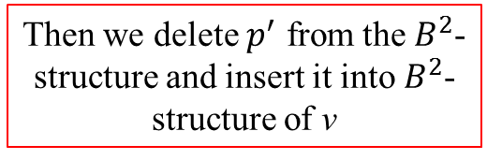
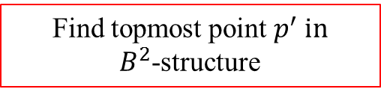
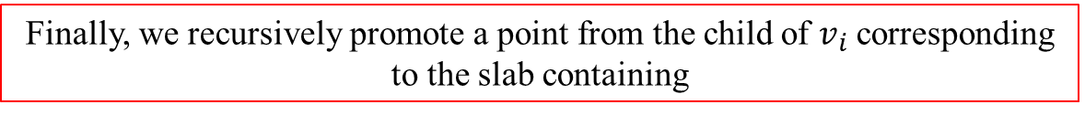
Update
To delete a point $p=(x,y)$ from the external priority search tree. Then we delete p from $B^{2}$-structure.
For deletion we use bubble up procedure to update secondary structure
Then we delete $p^{′}$ from the $B^{2}$-structure and insert it into $B^{2}$-structure of v
Find topmost point $p^{′}$ in
$B^{2}$-structure
Finally, we recursively promote a point from the child of $v_{i}$ corresponding
to the slab containing
Combinatorial and Geometric Algorithms Lab
Department of Computer Science.Yazd University

Slide 34
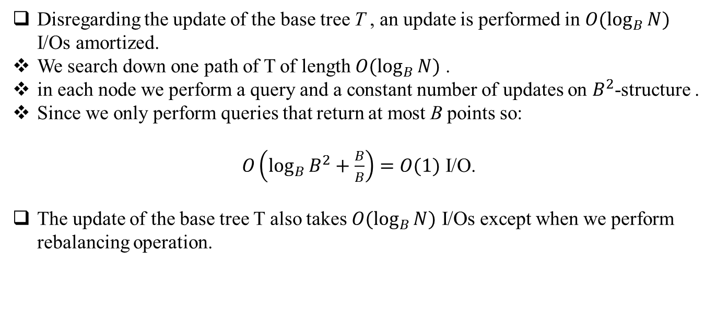
Update
Disregarding the update of the base tree T , an update is performed in $O(\log_{B}{N})$ I/Os amortized.
We search down one path of T of length $O(\log_{B}{N})$ .
in each node we perform a query and a constant number of updates on $B^{2}$-structure .
Since we only perform queries that return at most B points so:
$O\left(\log_{B}{B^{2}}+\frac{B}{B}\right)=O(1)$ I/O.
The update of the base tree T also takes $O(\log_{B}{N})$ I/Os except when we perform rebalancing operation.
Combinatorial and Geometric Algorithms Lab
Department of Computer Science.Yazd University

Slide 35
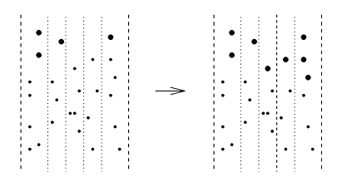
Update
Consider rebalancing operation
v
v’
v’’
New slab may cause slab contains too few points
Combinatorial and Geometric Algorithms Lab
Department of Computer Science.Yazd University

Slide 36
Update
Thus we need to promote at most $B$ points from $v^{′}$ and $v^{′′}$ to $B^{2}$-structure.
We can do so simply by performing $O(B)$ bubble-up operations. So the I/O cost is:
$O(B \log_{B}{w\left(v\right)})$ I/O
we know that when performing a split on v (during an insertion) $Ω(w\left(v\right))$ updates must have been performed below v since it was last involved in a rebalance operation.
Thus an insertion is performed in ${O(log}_{B}{N)}$ I/Os amortized.
The deletion is similar to insertion
Combinatorial and Geometric Algorithms Lab
Department of Computer Science.Yazd University

Slide 37

Any Questions?
Combinatorial and Geometric Algorithms Lab
Department of Computer Science.Yazd University

